Slide 1
Software Design & Architecture
Week 03
Abeeha Sattar

Slide 2
Basic Characteristics of the Unified Process
Object-oriented
Use-case driven
Architecture centric
Iteration and incrementation

Slide 3
Goals and Features of Each Iteration
Slowly chip away at the project risks:
performance risks
integration risks (different vendors, tools, etc.)
conceptual risks (hunt out analysis and design flaws)
Perform a “miniwaterfall” project that ends with a delivery of
something tangible in code.
Each iteration is risk-driven.
The result of a single iteration is an incremental improvement.

Slide 4
Unified Process Phases
Inception
Define business case, risks, 10% requirements identified, estimate next phase effort.
Elaboration
Understanding of problem / architecture, risk significant units are coded/tested, 80% requirements identified.
Construction
System design, programming and testing.
Transition
Deploy the system in its operating environment.

Slide 5
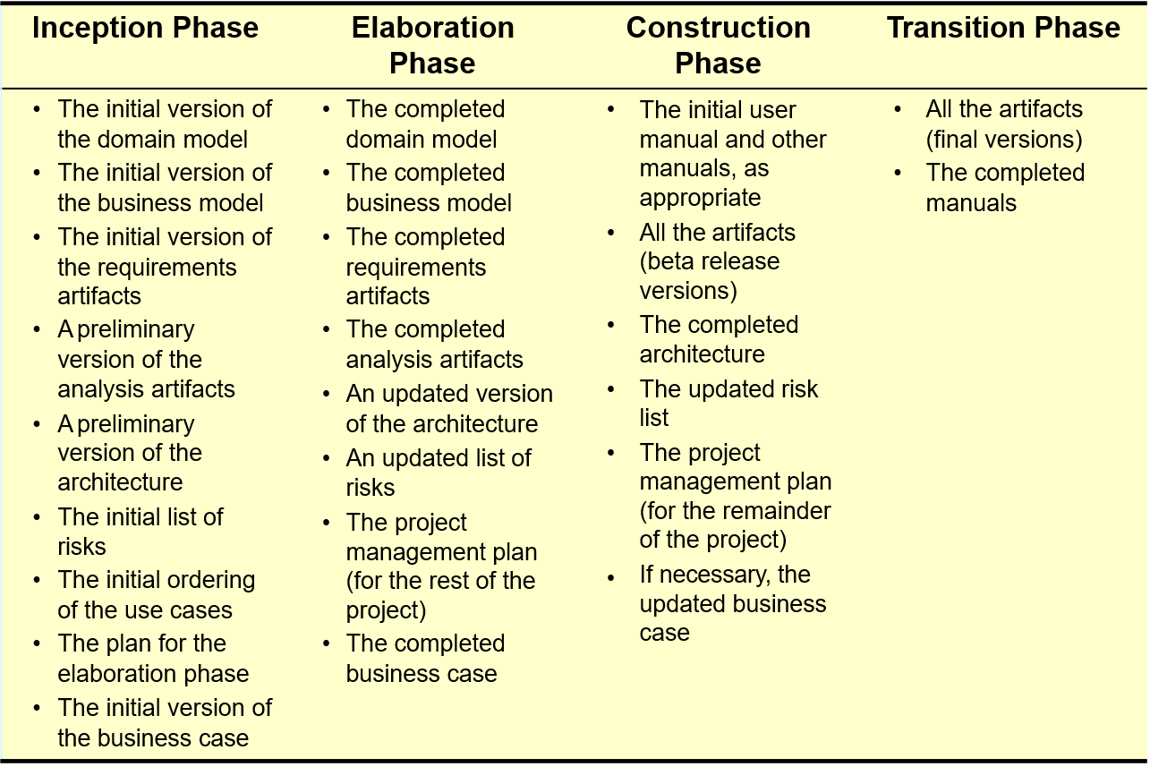
Phase Deliverables

Slide 6
Example roles in UP
Stake Holder: customer, product manager, etc.
Software Architect: established and maintains architectural vision
Process Engineer: leads definition and refinement of Development Case
Graphic Artist: assists in user interface design, etc.

Slide 7
Planning Workflow
Define scope of Project
Define scope of next iteration
Identify Stakeholders
Capture Stakeholders expectation
Build team
Assess Risks
Plan work for the iteration
Plan work for Project
Develop Criteria for iteration/project closure/success
UML concepts used: initial Business Model, using class diagram

Slide 8
Inception
First phase of the unified process

Slide 9
Inception
Inception is the initial short step to establish a common vision and basic scope for the project.
It will include analysis of perhaps 10% of the use cases, analysis of the critical non-functional requirement, creation of a business case, and preparation of the development environment so that programming can start in the following elaboration phase.

Slide 10
Inception
Inception in one sentence:
Envision the product scope, vision, and business case.
The main problem solved in one sentence:
Do the stakeholders have basic agreement on the vision of the project, and is it worth investing in serious investigation?

Slide 11
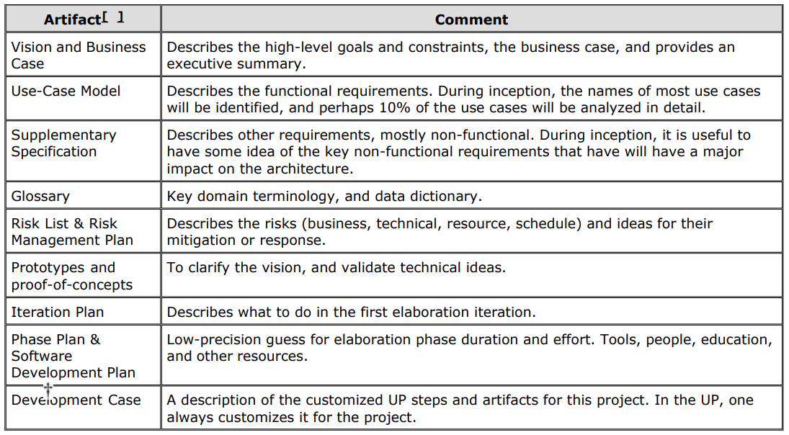
Inception Artifacts

Slide 12
Identifying Requirements
A requirement may range from a high-level abstract statement of a service or of a system constraint to a detailed mathematical functional specification
There are two types of requirements:
User Requirements:
Written for customers.
Often written in natural language (no technical details)
System Requirements:
Written for developers
Detailed functional and non-functional requirements discussed.
Include clear implementation details

Slide 13
System Stakeholders
End users
System managers
System owners
External stakeholders

Slide 14
Functional Requirements:
Statements of services the system should provide
How the system should react to particular inputs and in particular situations.
May state what the system should not do

Slide 15
Non-functional requirements
Constraints on the services or functions offered by the system such as timing constraints, constraints on the development process, standards, etc.
Similar to Quality attributes
Non-functional requirements may be more critical than functional requirements. If these are not met, the system may be useless

Slide 16
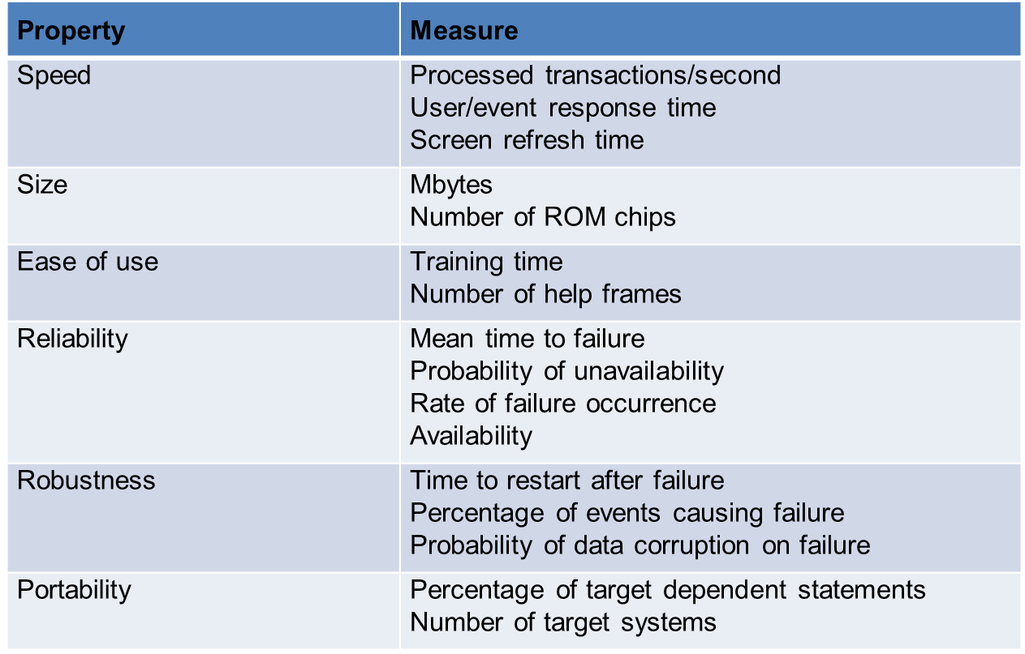
Non-functional requirements

Slide 17
Use Cases

Slide 18
Actors, Scenarios & Use Cases
An actor is something with behavior, such as a person (identified by role), computer system, or organization; for example, a cashier.
A scenario is a specific sequence of actions and interactions between actors and the system; it is also called a use case instance.
A use case is a collection of related success and failure scenarios that describe an actor using a system to support a goal.

Slide 19
Use Case Model
Use cases are text documents, not diagrams, and use-case modeling is primarily an act of writing text, not drawing diagrams.

Slide 20
Types of Actors
Primary actor has user goals fulfilled through using services of the system. For example, the cashier.
Why identify?
To find user goals, which drive the use cases.

Slide 21
Types of Actors
Supporting actor provides a service (for example, information) to the system. The automated payment authorization service is an example. Often a computer system, but could be an organization or person.
Why identify?
To clarify external interfaces and protocols.

Slide 22
Types of Actors
Offstage actor has an interest in the behavior of the use case, but is not primary or supporting; for example, a government tax agency.
Why identify?
To ensure that all necessary interests are identified and satisfied. Offstage actor interests are sometimes subtle or easy to miss unless these actors are explicitly named.

Slide 23
Types of Use Cases
Brief:
Terse one-paragraph summary, usually of the main success scenario.
Used during early requirements analysis, to get a quick sense of subject and scope. May take only a few minutes to create.
Example:
Process Sale: A customer arrives at a checkout with items to purchase. The cashier uses the POS system to record each purchased item. The system presents a running total and line-item details. The customer enters payment information, which the system validates and records. The system updates inventory. The customer receives a receipt from the system and then leaves with the items.

Slide 24
Types of Use Cases
Casual
Informal paragraph format. Multiple paragraphs that cover various scenarios.
Used during early requirements analysis, to get a quick sense of subject and scope. May take only a few minutes to create.
Example:
Handle Returns:
Main Success Scenario: A customer arrives at a checkout with items to return. The cashier uses the POS system to record each returned item …
Alternate Scenarios: If the customer paid by credit, and the reimbursement transaction to their credit account is rejected, inform the customer and pay them with cash. If the item identifier is not found in the system, notify the Cashier and suggest manual entry of the identifier code (perhaps it is corrupted).

Slide 25
Types of Use Cases
Fully dressed
All steps and variations are written in detail, and there are supporting sections, such as preconditions and success guarantees.
After many use cases have been identified and written in a brief format, then during the first requirements workshop a few (such as 10%) of the architecturally significant and high-value use cases are written in detail.

Slide 26
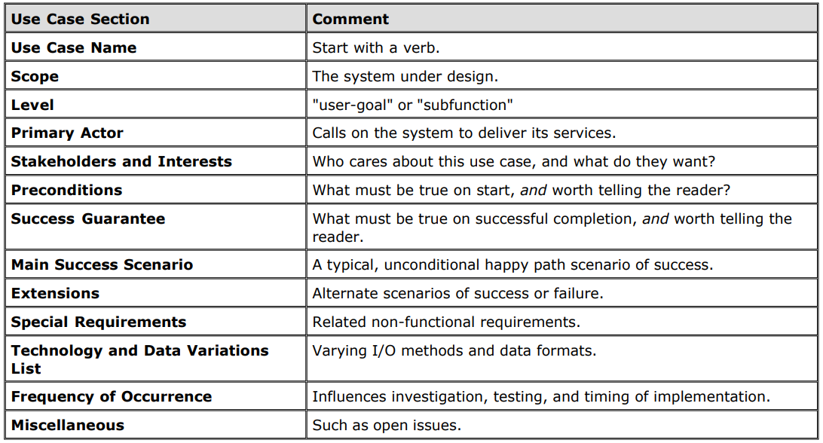
Fully Dressed Use Case
Notes:
Example : Pg. 118 in 2nd edition Applying UML & Patterns (pdf)

Slide 27
How to Find Use Cases?
1. Choose the system boundary. Is it just a software application, the hardware and application as a unit, that plus a person using it, or an entire organization?
2. Identify the primary actors. Those that have goals fulfilled through using services of the system.
3. Identify the goals for each primary actor.
4. Define use cases that satisfy user goals; name them according to their goal. Usually, user-goal level use cases will be one-to-one with user goals, but there is at least one exception, as will be examined.

Slide 28
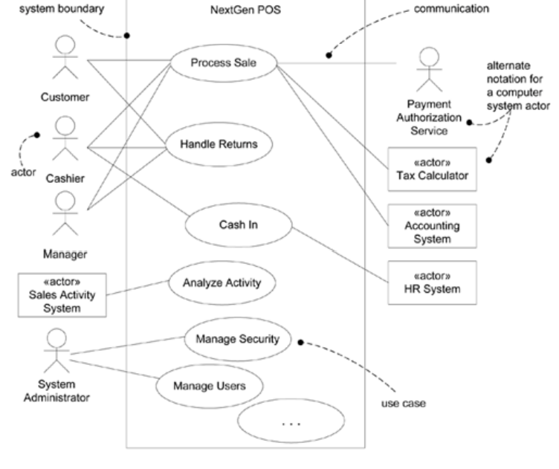
Use Case Diagram

Slide 29
Guidelines for UC Diagrams
- Have a system boundary
- Primary Actors on the left
- Supporting Actors on the right

Slide 30
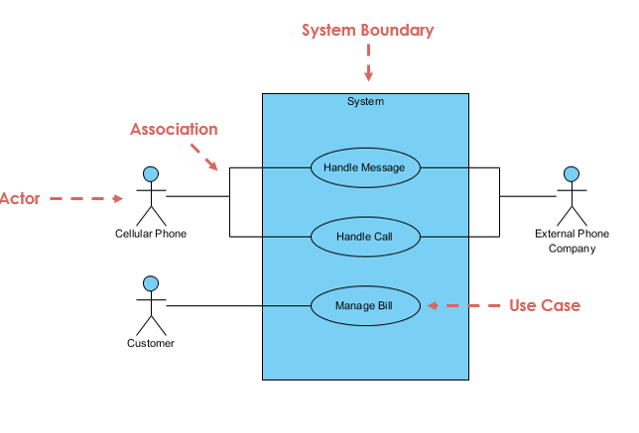
Elements of Use Case Diagram

Slide 31
Actor
Someone interacts with use case (system function).
Named by noun.
Actor plays a role in the business
Actor has a responsibility toward the system (inputs), and Actor has expectations from the system (outputs).

Slide 32

Use Case
System function (process - automated or manual)
Named by verb + Noun (or Noun Phrase).
i.e. Do something
Each Actor must be linked to a use case, while some use cases may not be linked to actors.

Slide 33
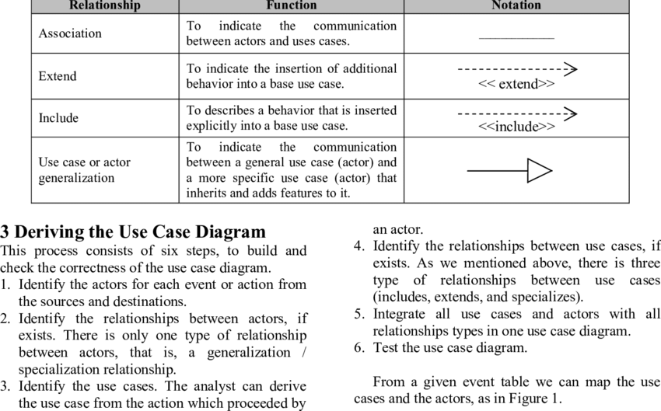
Types of Relationships

Slide 34

Association Link
A Use Case diagram illustrates a set of use cases for a system, i.e. the actors and the relationships between the actors and use cases.

Slide 35
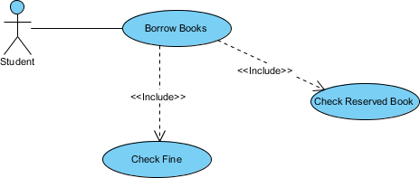
Include Relationship
The include relationship adds additional functionality not specified in the base use case.

Slide 36

Extend relationship
They are important because they show optional functionality or system behavior.

Slide 37
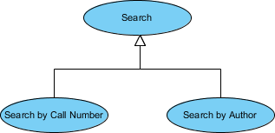
Generalization relationship
It means that a child use case inherits the behavior and meaning of the parent use case. The child may add or override the behavior of the parent. The figure below provides a use case example by showing two generalization connectors that connect between the three use cases.

Slide 38
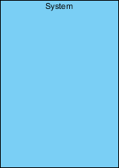
Boundary of system
The system boundary is potentially the entire system as defined in the requirements document.

Slide 39
EXAMPLES

Slide 40
Case Study – Write a Use Case
An executive at a chain of family restaurants called Brampton's Pizza and Pasta. They are looking to develop some software for in-house use at their restaurants. Their goal is to take the restaurant ordering process and make it more efficient. She is thinking that customers should be able to view the menu of the restaurant they're in, and once they're ready, place an order. She'd really like there to be a kids' page where you can see the kids' menu. Maybe there's a few games for the kids to play, but most importantly, it should be easy enough to use that kids can make an order themselves. Customers should also be able to specify any changes they'd like to make for their meal, and they should be able to list any dietary restrictions they may have before they submit their order to the kitchen. The kitchen should then be able to view these orders as they come in. Customers should be able to view and pay their bill within the system.

Slide 41
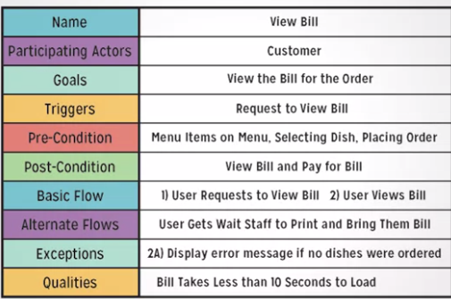
Use Case : Solution

Slide 42
Identify Use Cases
Automated Teller Machine (ATM) is a banking system. This banking system allows customers or users to have access to financial transactions. These transactions can be done in public space without any need for a clerk, cashier, or bank teller. The user is authenticated when enters the plastic ATM card in a Bank ATM, Then enters the user name and PIN (Personal Identification Number). For every ATM transaction, a Customer Authentication is required and essential. User checks the bank balance as well as also demands the mini statement about the bank balance if they want. Then the user withdraws the money as per their need. If they want to deposit some money, they can do it. After complete action, the user closes the session. If there is any error or repair needed in Bank ATM, it is done by an ATM technician. ATM technician is responsible for the maintenance of the Bank ATM, upgrades for hardware, firmware or software, and on-site diagnosis.

Slide 43
Functional Requirements
The Problem:
Currently, there are no applications dedicated to students in universities. Students want to participate in university courses and see announcements in these courses, but have this information spread out on multiple websites, which are hard to find. They want to find fellow students with the same interests and share their opinion about courses and course material, however this is not possible yet. They also want to discuss exam questions and find the right place where the exam takes place without searching on Google.

Slide 44
Functional Requirements
Scenarios:
Jack, an incoming student from US, is studying computer science at TUM. He has business administration as minor subject and is already used to visit the courses in the computer science building. The business administration courses however, are located in a lecture hall in another building in the city center of Munich. He never visited the other building before, so he does not know how to find the lecture halls for his minor subject. He browses through the courses in the course catalog of the University App and finds the course “Foundations of Business Administration” with course times and the location of the lecture hall on a map. While he is attending the course, he makes contact with fellow students who also attend the course and reads their comments. He likes one comment “Great exercises” by Jenny, who is also studying informatics. From Jenny’s picture, he remembers that they met a week ago at the coffee machine. He requests friendship with Jenny (she might help him to pass the final) and adds a new comment about exam questions from earlier exams. While he is browsing, Jenny is notified about the friend request and accepts it. jack, in turn, is notified that Jenny has accepted his request and now browses through all the courses that Jenny is visiting. He finds another interesting course “Cost Accounting” that he wants to visit and saves it into his course list.

Slide 45
Possible Solutions
FR1: Search for available courses: A student can see all courses of the current semester in his major and minor subject. He is able to join the course which saves it into his course list. He can also drop a course.
FR2: Check course details: A student can see details about a course such as the course times, the location of the lecture hall on a map and other course attendees including their name and picture.
FR3: Update profile: A student can update his profile settings and his profile picture. He can also change the notification settings.
FR4: Add comments: A student can add comments about a course and thus start a discussion. Others can like the comment and write follow-up comments.
FR5: Request friendship: A student can request friendship with another student who then receives a notification about the request. The second student can accept and reject friendship which both notifies the first student.
FR6: Browse friends’ courses: A student can browse the courses of his friends.
FR7: View announcements: A student can view course announcements and comment/like them.
FR8: Post updates to timeline: A student can post updates to his timeline. Friends are notified about updates and can comment and like them. Certain updates are posted automatically such as saving a course into the course list or commenting on a course.
FR9: See course calendar: A student can see all courses in a calendar.

Slide 46
Fin.

